Slide 1
Column Elimination: An Iterative Approach to Solving Arc Flow Formulations
Anthony Karahalios
Dissertation Defense

Slide 2
Outline Part I
Chapter 1
Introduction
Chapter 2
Discrete Optimization Methodologies
Chapter 3
Column Elimination for the Capacitated Vehicle Routing Problem
[K. & van Hoeve CPAIOR 2022]
Chapter 4
Column Elimination for Arc Flow Formulations
[K. & van Hoeve Major Revision OR]

Slide 3
Outline Part II
Chapter 5
Primal Heuristics for Arc Flow Formulations
Chapter 6
Cutting Planes for Arc Flow Formulations from Path Flow Formulations
Chapter 7
Variable Ordering for Column Elimination: A Portfolio Approach
[K. & van Hoeve Constraints 2022]
Chapter 8
Conclusion

Slide 4
Outline Part I
Chapter 1
Introduction
Chapter 2
Discrete Optimization Methodologies
Chapter 3
Column Elimination for the Capacitated Vehicle Routing Problem
[K. & van Hoeve CPAIOR 2022]
Chapter 4
Column Elimination for Arc Flow Formulations
[K. & van Hoeve Major Revision OR]

Slide 5
Introduction
These definitions will be useful.
An optimization problem is to find the best decisions among a set of alternatives.
An optimization model is a mathematical description of an optimization problem.
An optimization method solves an optimization model.
A heuristic method finds a feasible solution.
An exact method finds an optimal solution with proof of its optimality.
It is often an iterative procedure that works from both sides – finding feasible solutions and proving better and better dual bounds.

Slide 6
Background
Column elimination builds on three foundational optimization models.
Dynamic programming
Integer linear programming
Decision diagrams
[Bellman 1957, Dantzig 1955, Lee 1959]

Slide 7
Outline Part I
Chapter 1
Introduction
Chapter 2
Discrete Optimization Methodologies
Chapter 3
Column Elimination for the Capacitated Vehicle Routing Problem
[K. & van Hoeve CPAIOR 2022]
Chapter 4
Column Elimination for Arc Flow Formulations
[K. & van Hoeve Major Revision OR]

Slide 8
Capacitated Vehicle Routing Problem
Problem Setup:
$K$ vehicles each with capacity $Q$.
Demands $di$ for each location $i∈\{1,2,…,N\}$.
Distances between each pair of locations.
A depot location where the vehicles must begin and end.
Problem Statement:
Assign each vehicle a route to satisfy the demand at each location and use the least total travel time.
Problem Application:
Delivery companies like FedEx, Amazon, USPS, etc.

Slide 9
Capacitated Vehicle Routing Problem
Example Instance and Example Solution:
The first vehicle drives to locations [0,1,2,0], which takes 25 minutes.
The second vehicle drives to locations [0,4,3,0], which takes 20 minutes.
The optimal solution value is 45 minutes.
Note that this presentation will consider much much larger instances.
5
10
10
5
5
10
[Dantzig & Ramser 1959]

Slide 10
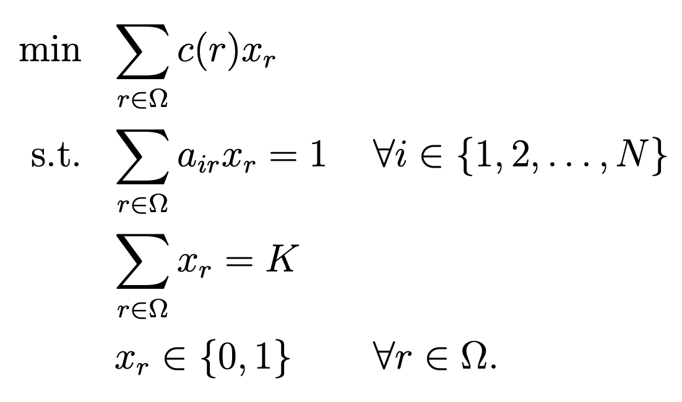
State-of-the-Art Model
Integer Programming Model:
Set $Ω$contains all feasible routes.
Binary variables $xr$for each r ∈ Ω.
1 if the route is used.
0 otherwise.
Function$c(r)$gives the time taken to complete a route.
Constraints ensure using $K$ routes and visiting each location.
[Fukasawa et al. 2006]

Slide 11
State-of-the-Art Method
Column Generation-Based Method:
The model is very large because $Ω$ has many routes.
A method that enumerates a variable for every route will be inefficient.
The state-of-the-art method is based on column generation.
Column generation solves the linear programming relaxation of the integer program model.
Embed column generation in branch-and-bound to solve the integer program.
[Fukasawa et al. 2006]

Slide 12
Column Generation
Column Generation Method:
Initialize a restricted set of routes $R′⊆Ω$. Routes are also known as columns.
Solve the model restricted to only use variables for routes in $R’$.
Find a route $r∈Ω\backslash R′$to add to $R′$ to improve the solution. Go to Step 2.
Or prove that no such route exists -> termination.
…
$$R′$$
$$Ω$$
[Fukasawa et al. 2006]

Slide 13
Column Generation
Column Generation Method:
Initialize a restricted set of routes $R′⊆Ω$. Routes are also known as columns.
Solve the model restricted to only use variables for routes in $R’$.
Find a route $r∈Ω\backslash R′$to add to $R′$ to improve the solution. Go to Step 2.
Or prove that no such route exists -> termination.
…
$$Ω$$
$$R′$$
[Fukasawa et al. 2006]

Slide 14
State-of-the-Art Performance
Computational Research for Vehicle Routing Problems:
Benchmark instances are used to compare the performance of different methods.
First Set of Benchmark Instances:
Each instance has between 30-100 locations [Augerat et al. 1995]
All instances have been solved [Pecin et al. 2014]
Second Set of Benchmark Instances:
Each instance has between 100 and 1000 locations [Uchoa et al. 2017]
38/68 instances with up to 500 customers have been solved. [Pessoa et al. 2020]
2/32 instances with 500-1000 customers have been solved. [Pessoa et al. 2020]
These are closer to the size that a real-world company might encounter.

Slide 15
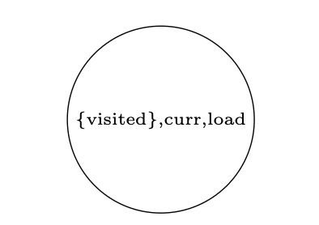
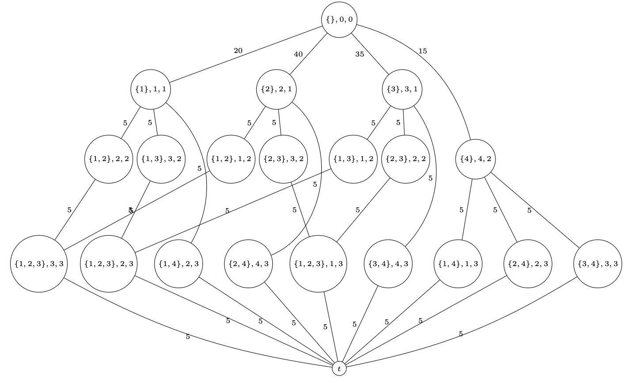
Column Elimination Model
Step 1 - Dynamic Program:
Enumerates the set of routes $Ω$ as paths through a state-transition graph.
The states indicate the set of visited locations, current location, and load.
The initial state is {}, 0, 0, meaning that the vehicle starts at the depot.
The arcs indicate travelling to the next location, which updates the state.
A path from the initial state to terminal state is feasible route.
*The state-transition graph omits some arcs that go directly to the depot.

Slide 16
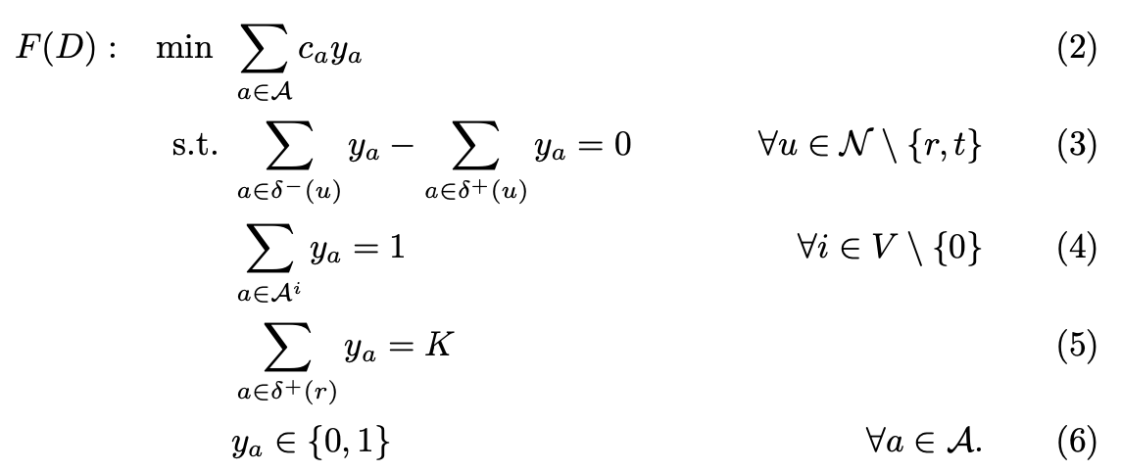
Column Elimination Model
Step 2 - Arc Flow Model:
An arc flow model is an integer linear program based on the state-transition graph.
There is a variable $ya$ for each arc in the state-transition graph.
A solution is $K$ paths, each from root to terminal, such that each location is visited by one path.
[de Lima et al. 2020]

Slide 17
Column Elimination Model
The Arc Flow Model is Equivalent to the Column Generation-Based Model:
The set of solutions are the same.
The solution values for this set of solutions are the same.
+
=

Slide 18
Column Elimination Model
Arc Flow Model Notes:
The arc flow model is expressive.
It has a variable for each arc instead of each path.
The arc flow model has fewer variables than the column generation-based model.
But it can still be too large for an off-the-shelf linear programming solver to directly solve the model.
Column elimination aims to overcome the large size of the arc flow model by working with smaller relaxations of the arc flow model.
+

Slide 19
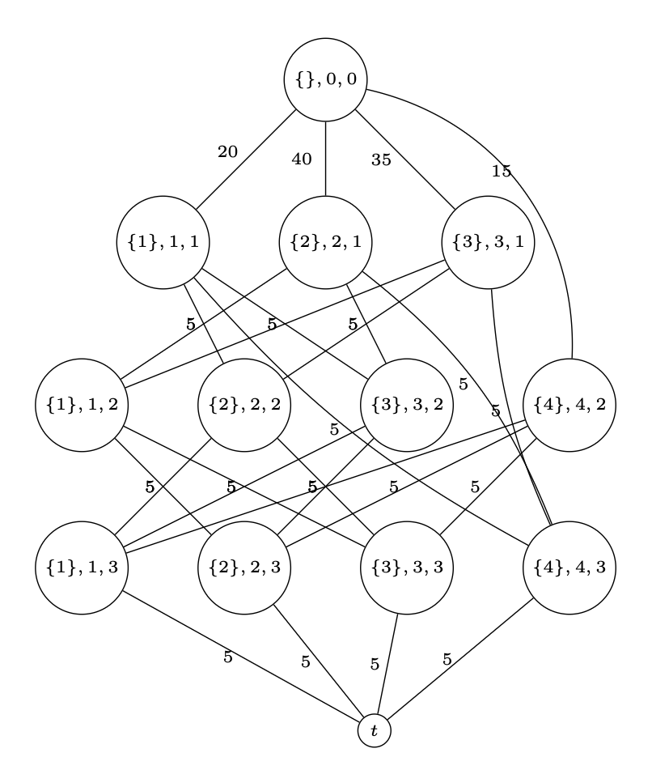
Column Elimination Method
Step 1 - Create a Relaxed Dynamic Program:
The relaxed dynamic program below has states that only remember the last visited location, which allows some paths to visit a location multiple times.
It has a superset of the feasible routes.
It has fewer nodes and arcs.
[Fukasawa et al. 2006]

Slide 20
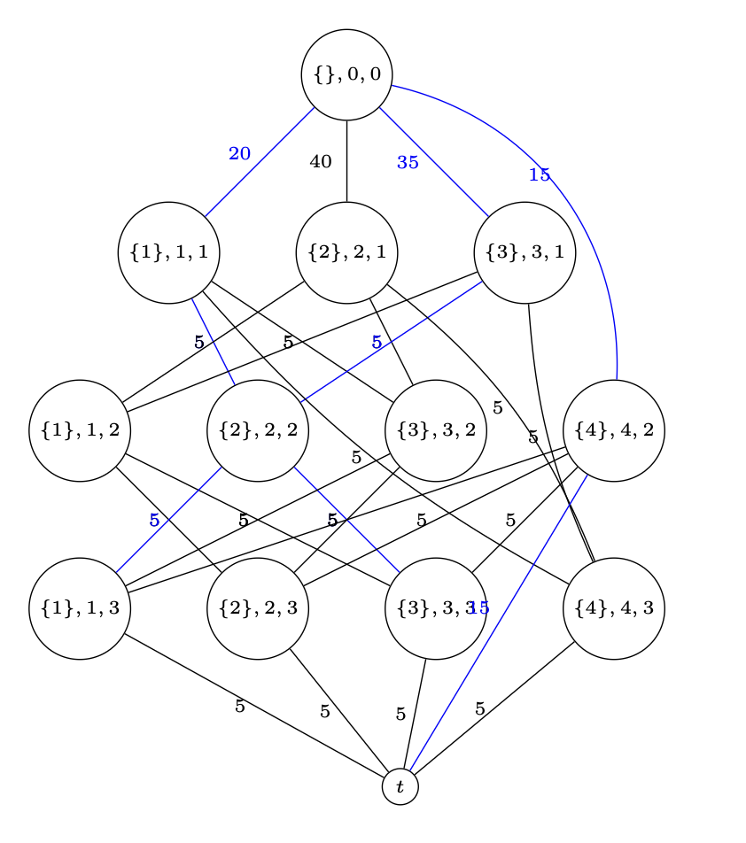
Column Elimination Method
Step 2 - Solve the Linear Programming Relaxation of the Arc Flow Model:
It is common to solve the linear programming relaxation as a first step to solve an integer linear program.
A (fractional) solution can include routes that are infeasible because they visit a location multiple times.

Slide 21
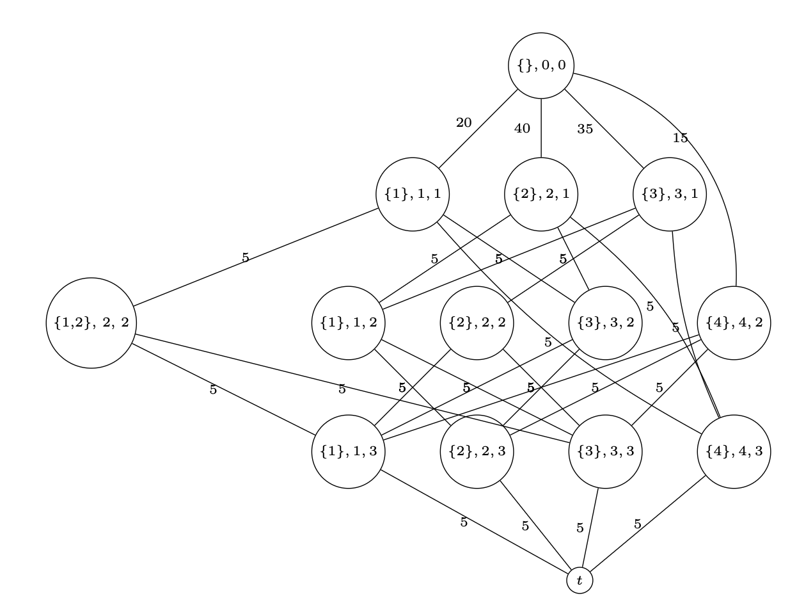
Column Elimination Method
Step 3 - Update the Dynamic Programming Relaxation to Remove an Infeasible Route:
Follow the states in an infeasible route. If the state is not the true state:
Make a node with the correct state.
Move the ingoing arc to the new node.
Copy the outgoing arcs from the node that the route currently visits.

Slide 22
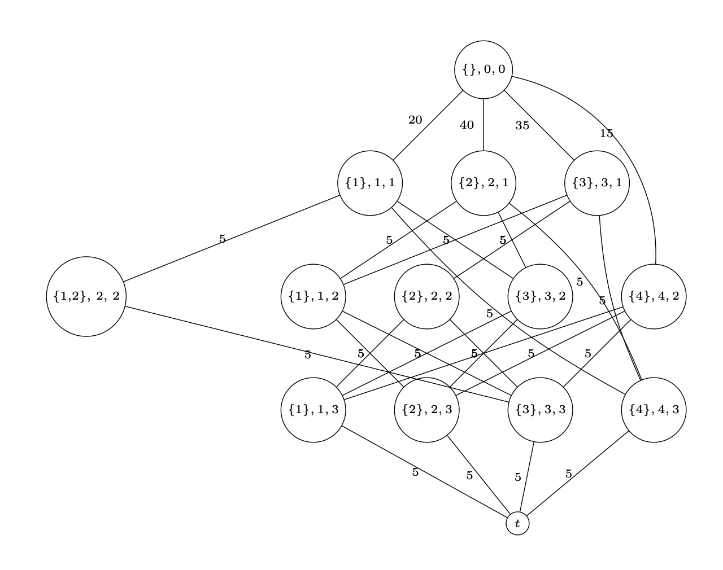
Column Elimination Method
Step 3 - Update the Dynamic Programming Relaxation to Remove an Infeasible Route:
Remove any infeasible arcs based on the new state.
Repeat until the infeasibility is removed.
All feasible routes are still paths in the updated state-transition graph.

Slide 23
Column Elimination Method
Method Summary:
Initialize a dynamic programming relaxation.
Solve the linear programming relaxation of the arc flow model.
Perform a path decomposition and check if any paths in the solution are infeasible.
If a path is infeasible, remove it and return to step 2. Otherwise, terminate.
At termination, the solution is optimal for LP(F).
The hope is that the dynamic program relaxation is still compact.

Slide 24
Column Elimination Method
The Method Solves the Linear Programming Relaxation. Then the Integer Program:
The linear programming relaxation is much easier to solve and its solution can be helpful to solve the integer program.

Slide 25
Secret Sauce
Lagrangean Method
Instead of solving the linear programming relaxation and then updating the dynamic program relaxation, simultaneously solve and refine with subgradient descent.
An efficient successive shortest paths algorithm in [Wang et al. 2020] solves the Lagrangean subproblem, which is a minimum cost flow problem.
Variable Fixing
A mathematical argument can prove that some arcs will never be used in an optimal solution, which reduces the size of the graph.
Cutting Planes
Additional constraints that strengthen the linear programming relaxation of the arc flow formulation.

Slide 26
Secret Sauce: Formal Results
Lagrangean Method
Variable Fixing
Cutting Planes

Slide 27
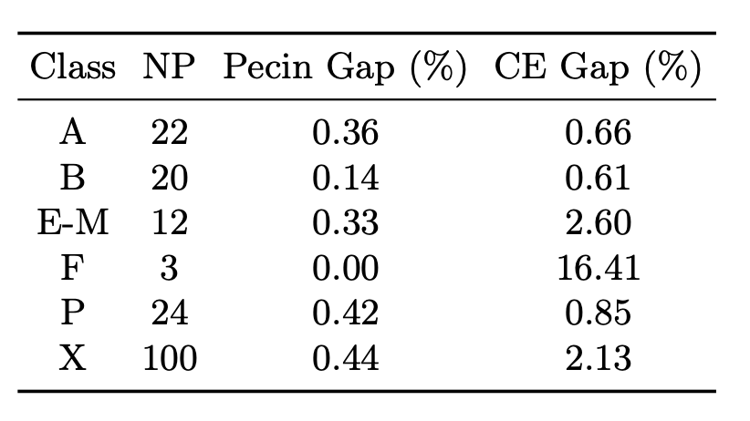
Experimental Results
Comparison with the State-of-the-Art Method on Benchmark Instances:
The gap (%) is the optimality gap after 1 hour of runtime.
Column elimination performed well, but did not outperform the state-of-the-art.
This was still good news, because there has not been another serious rival for the state-of-the-art method.
The Lagrangean method and variable fixing were most important.
[K. & van Hoeve 2022]
[Pecin et al. 2017]

Slide 28
Contributions
Previous works:
This work:
1. [van Hoeve MP 2020]
Problem: Graph Coloring Problem
Graph: Binary Decision Diagram
Refinement: Repetitions
Solving: LP then IP
3. [K. & van Hoeve CPAIOR 2022]
Problem: CVRP
Graph: Dynamic Program
Refinement: Repetitions
Solving: Lagrangean (Multi-Path) + Variable Fixing + Cutting Planes
2. [Tang & van Hoeve TS 2023]
Problem: Truck-Drone Routing Problem
Graph: Dynamic Program
Refinement: Repetitions
Solving: Lagrangean (Single Path)

Slide 29
Outline Part I
Chapter 1
Introduction
Chapter 2
Discrete Optimization Methodologies
Chapter 3
Column Elimination for the Capacitated Vehicle Routing Problem
[K. & van Hoeve CPAIOR 2022]
Chapter 4
Column Elimination for Arc Flow Formulations
[K. & van Hoeve Major Revision OR]

Slide 30
General Problem Description
Problem Form:
$U$ is a set of elements.
$S$ is a set of arbitrary, but finite-length sequences of elements.
$f : S→ℝ$is a cost function for the sequences.
$C$ is a binary constraint function that returns if a set of sequences is feasible or not.
Does the Capacitated Vehicle Routing Problem fit this form?

Slide 31
General Problem Description: CVRP
Problem Form:
$U$ is a set of elements.
The set of locations.
$S$ is a set of arbitrary, but finite-length sequences.
The set of feasible routes.
$f : S→ℝ$is a cost function for the sequences.
The time taken by each route.
$C$ is a binary constraint function that returns if a set of sequences is feasible or not.
A solution requires K sequences and each location in one sequence.

Slide 32
General Model Assumption
One Assumption is Required to Model the Problem with an Arc Flow Model:
The constraints $C(X)$ are assumed to be expressed in terms of the conjunction of a set of constraints that correspond to additional cost functions for the sequences.
Each constraint has a cost function $γ:S→$ $ℝ.$
Each constraint has the following form:
So together, $C(X)$ has the following form:
The dynamic program must represent these additional cost functions.
Does such a dynamic program always exist?

Slide 33
General Model
The Arc Flow Model Simply Ensures Full Sequences are Used in Solutions:
The arc flow model uses the costs in the dynamic program for the objective value and the constraints.
Just as $c(a)$ represents $f$, $gj(a)$ represents the constraints in $C(X)$.

Slide 34
General Refinement Algorithm
Refining a Dynamic Program Relaxation:
The algorithm only requires a dynamic program, a dynamic program relaxation, and an infeasible sequence as input.
It removes the infeasible sequence from the dynamic program relaxation while maintaining a dynamic program relaxation.
It can also update relaxed arc costs.

Slide 35
General Problem: Formal Results
There exists an arc flow model for the general problem.
A new definition, dynamic program relaxation:

Slide 36
General Problem: Formal Results
The general refinement algorithm is correct.
Column elimination solves the arc flow formulation in a finite number of steps:

Slide 37
Experimental Results: Problems
Vehicle Routing Problem with Time Windows:
The capacitated vehicle routing problem, and now each location must be visited within a particular time window.
Pickup-and-Delivery Problem with Time Windows:
The vehicle routing problem with time windows, and now the locations come in supply/demand pairs.
Graph Multicoloring Problem:
The vertex coloring problem, and now each vertex can require more than one color.

Slide 38
Experimental Results: Performance
Vehicle Routing Problem with Time Windows:
Column elimination outperforms the state-of-the-art solver on some C2 instances.
Column elimination solves C2_10_1 (1000 locations) for the first time.
Pickup-and-Delivery Problem with Time Windows:
Column elimination is the first exact algorithm to give dual bounds for instances with more than 200 locations.
Column elimination solves five instances with 400-600 locations for the first time.
Graph Multicoloring Problem:
Column elimination solves five instances for the first time.

Slide 39
Experimental Results: Intuition
Vehicle Routing Problem with Time Windows:
For the C2 instances, the initial dynamic programming relaxation does not consider the load / capacity as part of its states; this works well because the tight time windows often make the capacity constraint implicitly respected.
Pickup-and-Delivery Problem with Time Windows:
The initial dynamic programming relaxation does not include precedence constraints, but it quickly introduces them, especially for short routes. The time windows can also help enforce some of them.
Graph Multicoloring Problem:
For sparse graphs, the solution to the initial dynamic program relaxation does not contain infeasible sequences.
While state-space relaxations are used in vehicle routing problems, they are not as common for the vertex coloring problem.

Slide 40
Contributions
Previous works:
This work:
1. [van Hoeve MP 2020]
Problem: Graph Coloring Problem
Graph: Binary Decision Diagram
Refinement: Repetitions
Solving: LP + IP
3. [K. & van Hoeve CPAIOR 2022]
Problem: CVRP
Graph: Dynamic Program
Refinement: Repetitions
Solving: Lagrangean (Multi-Path) + …
2. [Tang & van Hoeve TS 2023]
Problem: Truck-Drone Routing Problem
Graph: Dynamic Program
Refinement: Repetitions
Solving: Lagrangean (Single Path)
3. [K. & van Hoeve Major Revision OR]
Problem: Generic Sequence Problem
Graph: Dynamic Program
Refinement: Generic Refinement
Solving: Lagrangean (Multi-Path) + B&B

Slide 41
Outline Part II
Chapter 5
Primal Heuristics for Arc Flow Formulations
Chapter 6
Cutting Planes for Arc Flow Formulations from Path Flow Formulations
Chapter 7
Variable Ordering for Column Elimination: A Portfolio Approach
[K. & van Hoeve Constraints 2022]
Chapter 8
Conclusion

Slide 42
Motivation
Column Elimination Solves a Relaxation at Each Iteration:
A feasible solution to the original problem is only found at termination.
At each iteration, the relaxed arc flow formulation gives solutions that are infeasible to the original problem.
A Primal Heuristic Can Find Feasible Solutions Before Termination:
The infeasible solutions to the relaxed arc flow models may be useful.
A feasible solution gives a primal bound, helpful for reducing the size of the arc flow model with variable fixing.

Slide 43
Primal Heuristic
The Primal Heuristic Runs a Small Integer Program Over a Restricted Set of Sequences:
Initialize a restricted set of feasible sequences.
Add sequences from the solution at each iteration of column elimination.
Add feasible sequences or feasible variants of infeasible sequences.
Solve a small integer program over the restricted set of sequences.
Use a large neighborhood search to try to improve an initial feasible solution.

Slide 44
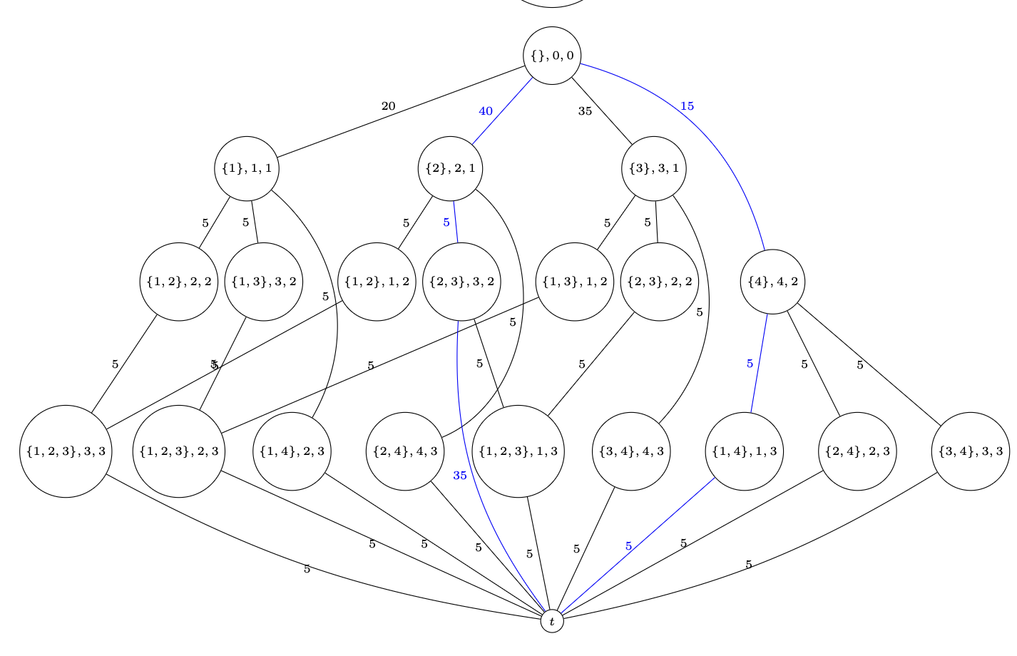
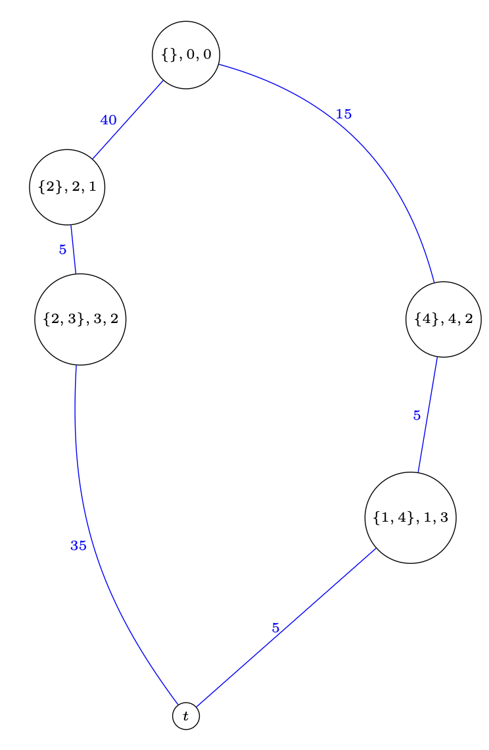
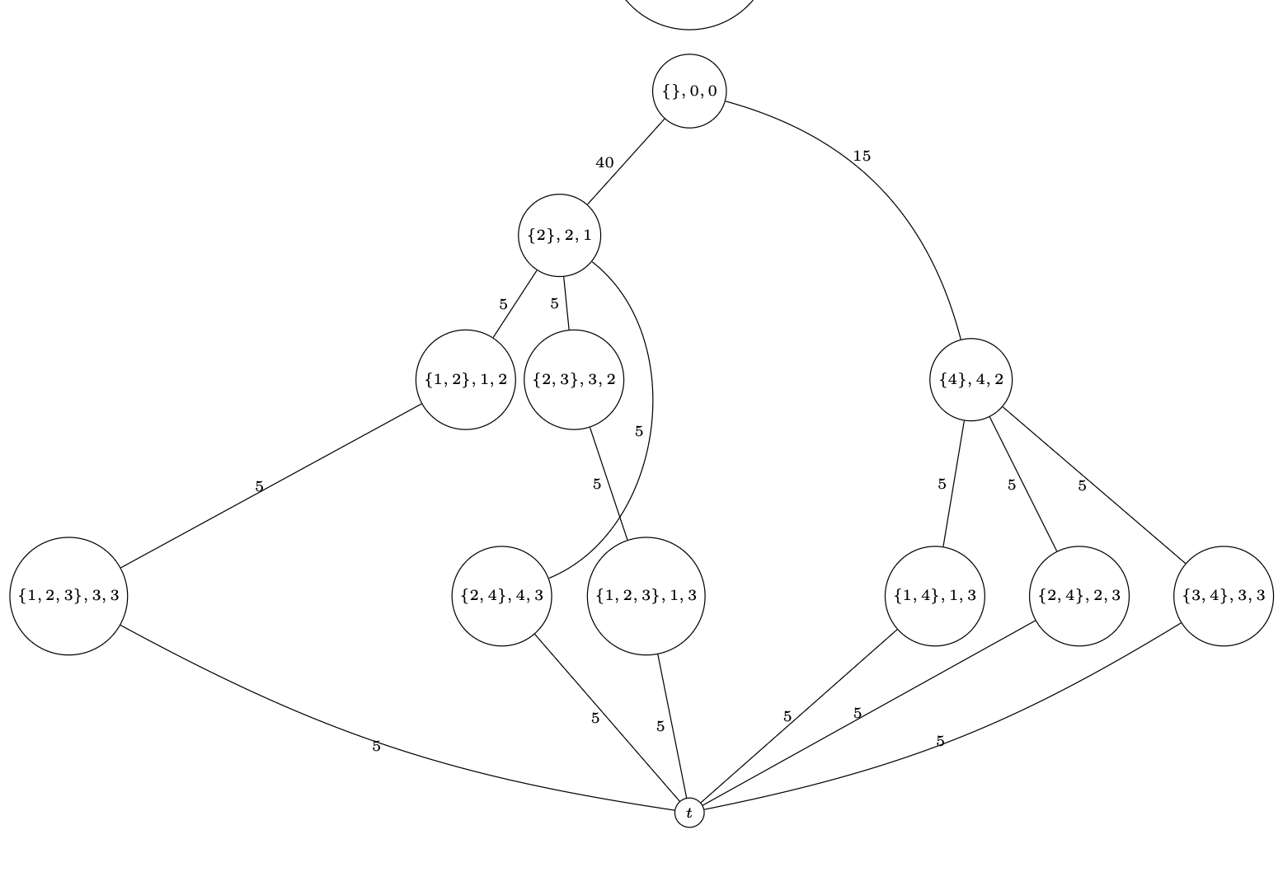
Large Neighborhood Search
A Large Neighborhood Search Aims to Improve an Initial Solution:
Remove some elements from each sequence in the solution (destroy phase).
Create a neighborhood of similar sequences by inserting the elements into the destroyed sequences wherever possible.
Use the dynamic program to do this efficiently.
Solve the restricted arc flow model over this neighborhood.

Slide 45
Formal Results
An Algorithm to Construct a Neighborhood:
An Upper Bound on the Size of the Neighborhood:

Slide 46
Experimental Results
The Primal Heuristic and Large-Neighborhood Search Improve Column Elimination:
For VRPTW instances,
The primal heuristic finds good feasible solutions for C1 instances.
The large neighborhood search makes improvements.

Slide 47
Experimental Results
The Primal Heuristic Compared With State-of-the-Art:
For CVRP instances, the primal heuristic finds reasonably good solutions
The solutions are not as good as a dedicated heuristic.
The state-of-the-art exact solver often does not find a feasible solution in 1hr.
If no solution is found, the gap value is 1.
[Pessoa et al. 2020, Wouda et al. 2024]

Slide 48
Outline Part II
Chapter 5
Primal Heuristics for Arc Flow Formulations
Chapter 6
Cutting Planes for Arc Flow Formulations from Path Flow Formulations
Chapter 7
Variable Ordering for Column Elimination: A Portfolio Approach
[K. & van Hoeve Constraints 2022]
Chapter 8
Conclusion

Slide 49
Motivation
The Optimality Gap of the Linear Programming Relaxation can be Large:
For VRPs,
The optimality gap can be 1-4%, which inhibits variable fixing from reducing the size of the arc flow model.
Cutting planes are very helpful in the state-of-the-art solver.
In column elimination,
Robust cutting planes have been implemented.
Non-robust cutting planes were formulated but not implemented effectively.
[Pecin et al. 2017]

Slide 50
Path Flow Model
Recall the Column Generation-Based (Path Flow) Model:
Let $Θ$ be the set of paths in the state-transition graph of an arc flow model.
The path flow model has a variable z$θ$ for each path.

Slide 51
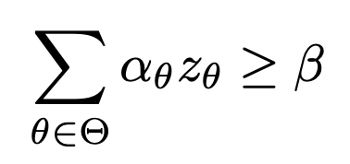
Cutting Planes in Path Flow Model
A Cutting Plane is a Valid Inequality to Improve the Linear Programming Relaxation:
In the path flow model, a cutting plane has a coefficient $αθ$ for each path $θ$.
Given an Arc Flow Model, maybe Impossible to Formulate an Equivalent Cutting Plane:
There may not be a way to assign coefficients to the arc flow variables that would make an equivalent cutting plane for the arc flow model.

Slide 52
Cutting Plane as Cost Function
An Arc Flow Model Exists with an Equivalent Cutting Plane:
The coefficients are an additional cost function over the sequences.
An exact dynamic program exists that includes this additional cost function, but still has the same sequences and costs as the original dynamic program.
Consider an existing dynamic programming relaxation.
Assume the coefficients $αθ$are all non-negative.
Set the additional cost function equal to 0 for the arcs.
The dynamic programming relaxation is still a dynamic programming relaxation for the updated exact dynamic program.

Slide 53
Translating a Cutting Plane
Incorporating These Cutting Planes with Column Elimination:
The input is a solution to the linear programming relaxation over a dynamic programming relaxation.
Use a path decomposition and search for a violated inequality.
Run the refinement algorithm on the paths whose flow violates the inequality.
The coefficients can now be appropriately expressed on those arcs to formulate the cutting plane in the arc flow model.

Slide 54
Example: Subset-Row Inequality
Subset-Row Inequalities in the Path Flow Model:
A subset-row inequality is a Chvátal-Gomory cutting plane.
Given a vector $0≤μ≤1$ the following coefficients produce a valid cutting plane.
[Jepsen et al. 2008]

Slide 55
Example: Subset-Row Inequality
Translate the Cutting Plane by Creating An Additional Cost Function:
The coefficient is based solely on the set of visited locations.
Consider an additional cost function that equals:
1 if the location increments the coefficient.
0 if the location does not increment the coefficient.
This only updates the arc costs for the existing state-transition graph for the exact dynamic program, does not change its structure.

Slide 56
Formal Results
The Refinement Algorithm Produces a Cutting Plane in the Arc Flow Formulation that is Equivalent to the Cutting Plane in the Path Flow Formulation:
The Refinement Algorithm has Bounded Impact on Size of the Arc Flow Formulation:
The Cost Function for the Subset-Row Inequalities is Correct:

Slide 57
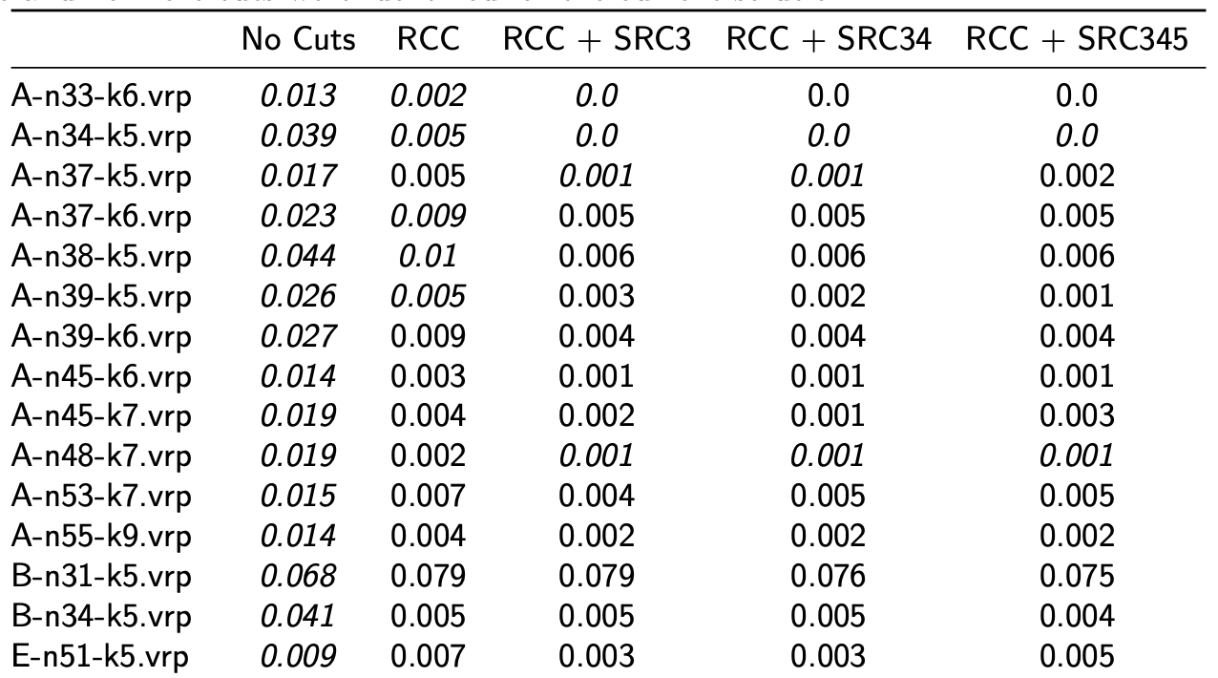
Experimental Results
Performance of Subset-Row Inequalities in Column Elimination:
The subset-row inequalities improve the linear programming relaxation of the arc flow model for many instances.

Slide 58
Outline Part II
Chapter 5
Primal Heuristics for Arc Flow Formulations
Chapter 6
Cutting Planes for Arc Flow Formulations from Path Flow Formulations
Chapter 7
Variable Ordering for Column Elimination: A Portfolio Approach
[K. & van Hoeve Constraints 2022]
Chapter 8
Conclusion

Slide 59
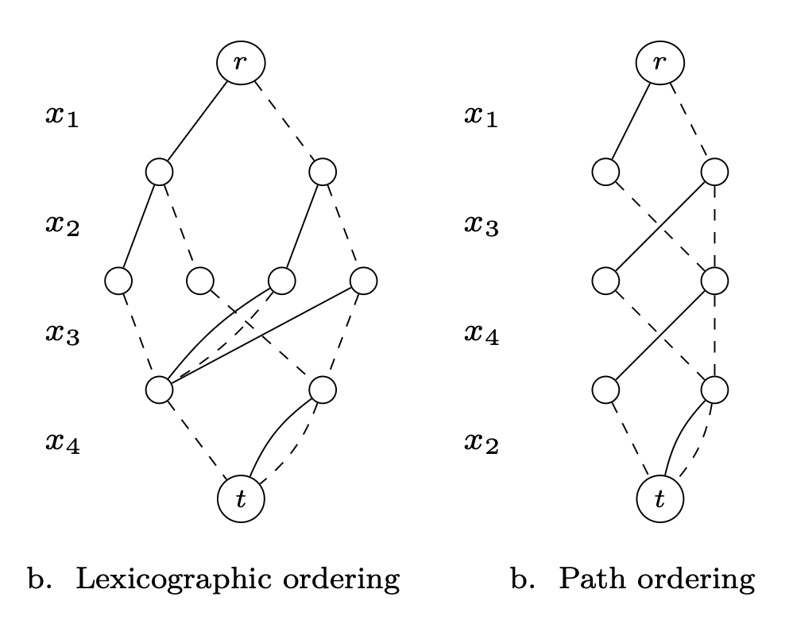
Motivation
Variable Ordering Affects the Performance of Column Elimination in [van Hoeve 2020].
A decision diagram is a layered graph that represents a set of solutions.
A variable ordering is an assignment of variables to layers of a decision diagram.
The variable ordering affects the size of a decision diagram.

Slide 60
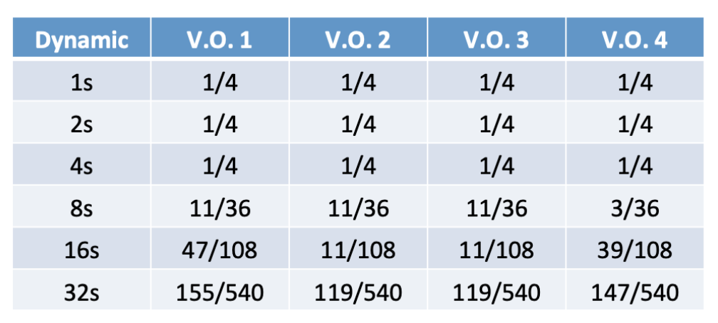
Portfolio of Variable Orderings
A Portfolio of Variable Orderings can Outperform a Single Variable Ordering:
No single variable ordering dominates others.
We consider different methods for allocating the runtime to the variable orderings.
This dynamic variable ordering strategy starts with uniform allocation and updates based on the performance of column elimination with each variable ordering.

Slide 61
Experimental Results
A Dynamic Variable Ordering Strategy Performed Best for DIMACS instances:
On some instances, this strategy outperforms an oracle that chooses the single best strategy, because one variable ordering might find the best primal bound and another might find the best dual bound.
[Held et al. 2012]

Slide 62
Outline Part II
Chapter 5
Primal Heuristics for Arc Flow Formulations
Chapter 6
Cutting Planes for Arc Flow Formulations from Path Flow Formulations
Chapter 7
Variable Ordering for Column Elimination: A Portfolio Approach
[K. & van Hoeve Constraints 2022]
Chapter 8
Conclusion

Slide 63
Conclusion
Some thoughts:
When does column elimination work well?
For large-scale problems where an arc flow model over a relaxed dynamic program can have a similar optimal solution value to the exact arc flow model.
Example – the vehicle routing problem with time windows has a capacity constraint and time constraints, but the properties of an instance might make one of these constraints nearly implicit.
For problems where relaxations are not often explored.
Example – methods to solve the vertex coloring problem do not often consider relaxing the concept of an independent set.
When there is a small optimality gap between the linear programming relaxation and the integer program. Variable fixing can work well here.
Example – some instances of large-scale vehicle routing problems.

Slide 64
Conclusion
Current collaborations:
Combining Column Generation and Column Elimination [UWaterloo CO]
Column Elimination for an Electric Vehicle Routing Problem [MIT ORC]
Column Elimination for a Multi-Resource Scheduling Problem [Bordeaux OR]
Combining Graph Master and Column Elimination [Optym]
Future work:
What other forms of problems can column elimination solve? (non-homogeneous sequences, stochastic, etc.)
Can column elimination inspire a new way to solve integer programs?
How can the method be improved? (efficiency of the Lagrangean method, cuts in the Lagrangean method, better variable fixing, better initial relaxations, relaxing the cost functions, etc.)

Slide 65
Thesis Committee
Merve Bodur – University of Edinburgh
“Wait… you should be excited about your thesis proposal – you’re the expert.”

Slide 66
Thesis Committee
Ricardo Fukasawa – University of Waterloo
“Even as a professor I sometimes have imposter syndrome.”

Slide 67
Thesis Committee
John Hooker – Carnegie Mellon University
“Operations Research is the most important field that you’ve never heard of.”

Slide 68
Thesis Committee
Fatma Kılınç-Karzan - Carnegie Mellon University
“Did you submit your job market paper yet?”

Slide 69
Thesis Committee
Willem-Jan van Hoeve - Carnegie Mellon University
“Did you use a vector-based image file?”

Slide 70
Thank you!
Acknowledgement: National Science Foundation, Friends, Family, Students, Faculty, Admins, Cleaning Staff, Baristas, Bartenders, Barbers, etc.
Questions / Comments?

